Slide 1

Amazon Sales Data

Slide 2
Introduction
Amazon was founded on July 5, 1994, by Jeff Bezos in Bellevue, Washington. The company originally started as an online marketplace for books but gradually expanded its offerings to include a wide range of product categories. This diversification led to it being referred to as "The Everything Store".
As of October 2023, Amazon is the 12th-most visited website in the world and 82% of its traffic comes from the United States.

Slide 3
Details OF data
Region
Country
Item Type
Sales Channel
Order Priority
Order Date
Order ID
Ship Date
Units Sold
Unit Price
Unit Cost
Total Revenue
Total Cost
Total Profit

Slide 4
Main KPI’S
Total Orders – Count of all the orders – 100
Total Units Sold – Sum of all the units sold – 513k
Revenue – Sum of total revenue earned during the years – 137M
Profit – Total Profit earned – 44.17M

Slide 5
Insights
Profit gets declined from 2012 with huge margin to 2013 and then slightly increase upto 2017.
In the month of February the sales were higher as compared to other months.
In Product Category, Cosmetics were having highest numbers of Sales and Profit than others.

Slide 6
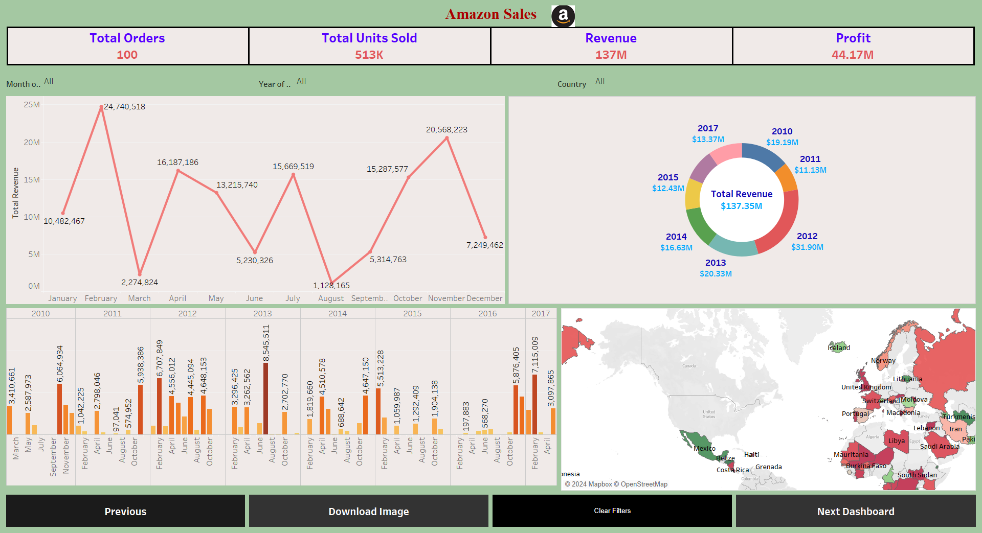
Mock – up dashboard

Slide 7
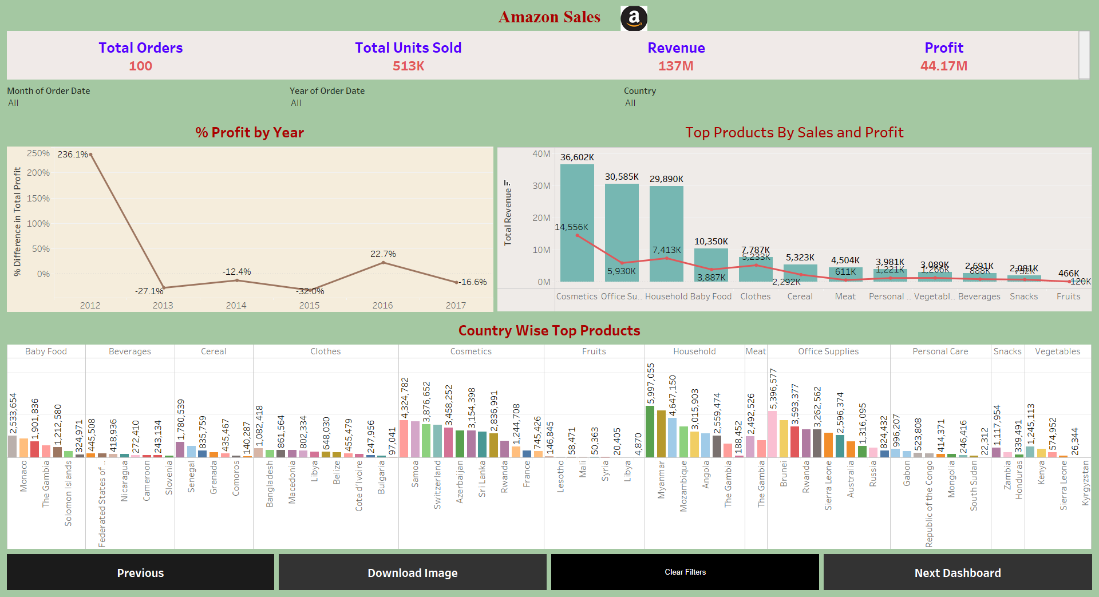
My Designs

Slide 8
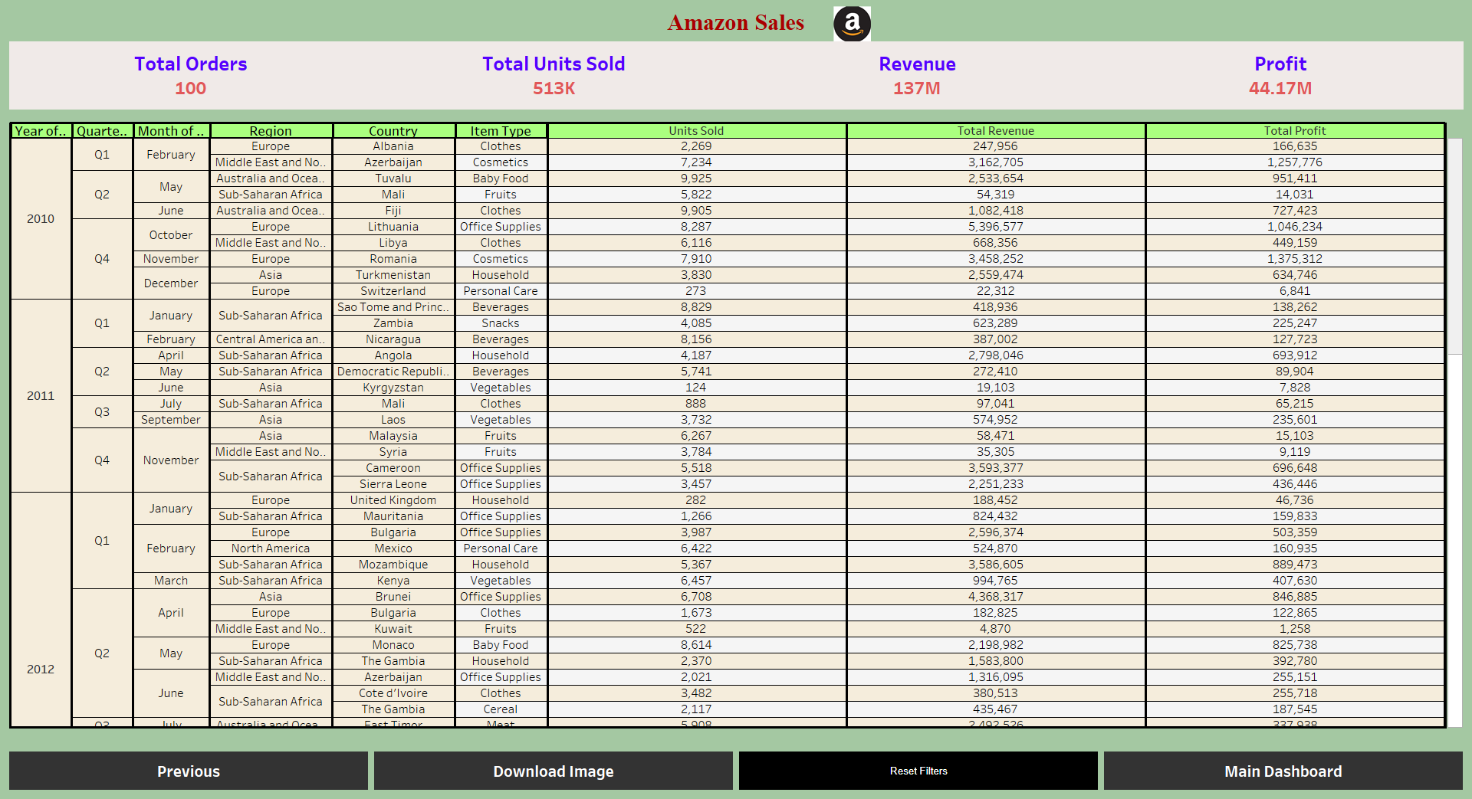

Slide 9


